Slide 1
Financial Adviser
A Project by Team: Agent_47

Slide 2
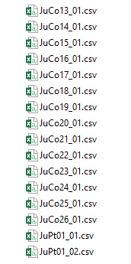
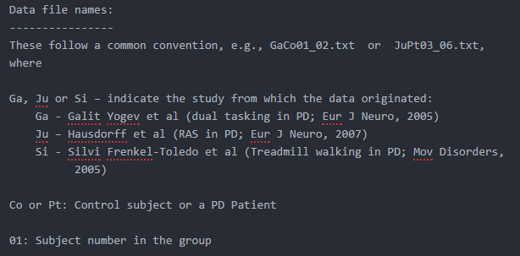
Dataset Description

Slide 3


Simple and Secure
Login with Bank Account Number

Slide 4
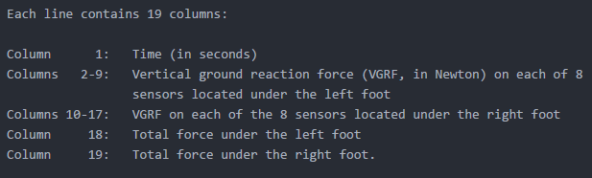
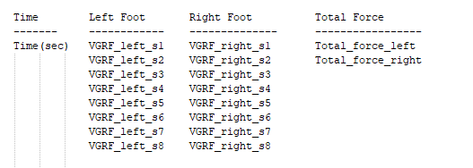
Features’
Description

Slide 5

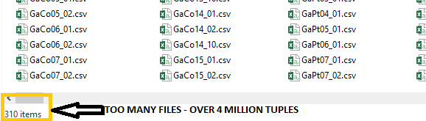
Need for Data Transformation
After successfully completing the project on two test files – one of Co and Pt each, we faced issues while scaling up.
About 4 million tuples forced us to look for alternatives – The computations took dozens of hours…
We chose to look at the statistical representation of data instead.

Slide 6

Statistical Functions Used
Minimum
Maximum
Since data can be represented by its distribution’s characteristics, we chose to apply the following 7 computations to each column of each file henceforth reducing about 12000 tuples, i.e. (1 file) into 1 tuple.
Standard Deviation
Median
Mean
Skewness
Kurtosis

Slide 7
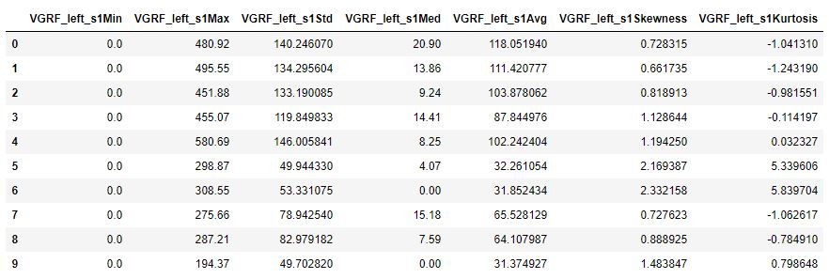
A few of the columns in the new dataset :
7 features selected :
Minimum
Maximum
Standard Deviation
Median
Average
Skewness
Kurtosis
One tuple in the new dataset represents the data of one file on the original dataset.
310 files = 310 tuples
Data Reduced significantly
Columns in new dataset =
total features*columns in old dataset
= 7*19 =133

Slide 8
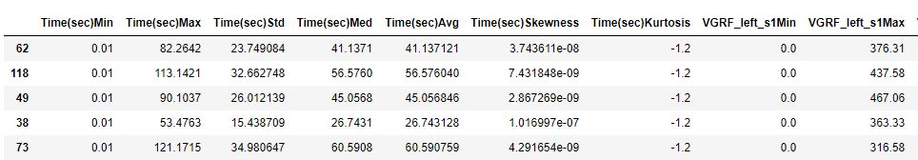
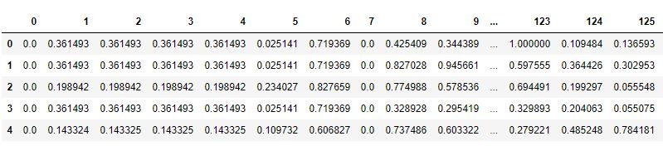
DATA SCALING:
MINMAX SCALING
Why we chose Minmax Scaling :
Makes data consistent
Less computational power required
Before Scaling :
Scales each feature to a given range, usually (-1,1)
After Scaling :

Slide 9
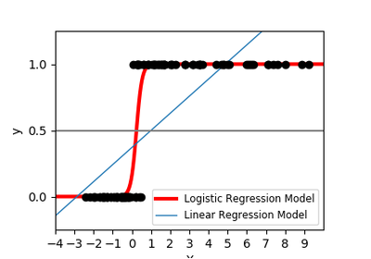
Logistic Regression
Transforms its output using the logistic sigmoid function to return a probability value which can then be mapped to two or more discrete classes.
Accuracy Obtained –
Min – 80%
Max – 93%
Average – 86.5%

Slide 10

Support Vector Classifier
And Kernels
Uses kernels to transform data into higher dimensional space to find a hyperplane which can separate the classes
We used the following kernels –
Linear
Sigmoid
Poly
RBF (Radial Basis Function)

Slide 11
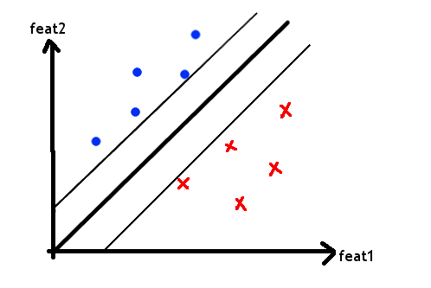
The Linear Kernel
Fits a linear hyperplane between the data points such that it maximizes the margins
Accuracy Obtained –
Min – 80%
Max – 87%
Average – 83.5%

Slide 12


The POLY
Kernel
Function used :
Transforms feature space into features that are polynomial combinations of original features.
Where,
x , y : features
p : degree
Accuracy achieved by our model :
Min : 87
Max : 92
Average : 89

Slide 13
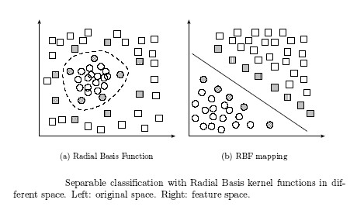
The RBF
Kernel
The feature space of the radial basis function (rbf) kernel maps to an infinite dimensional space.
Accuracy Obtained –
Min – 86%
Max – 90%
Average – 88%

Slide 14
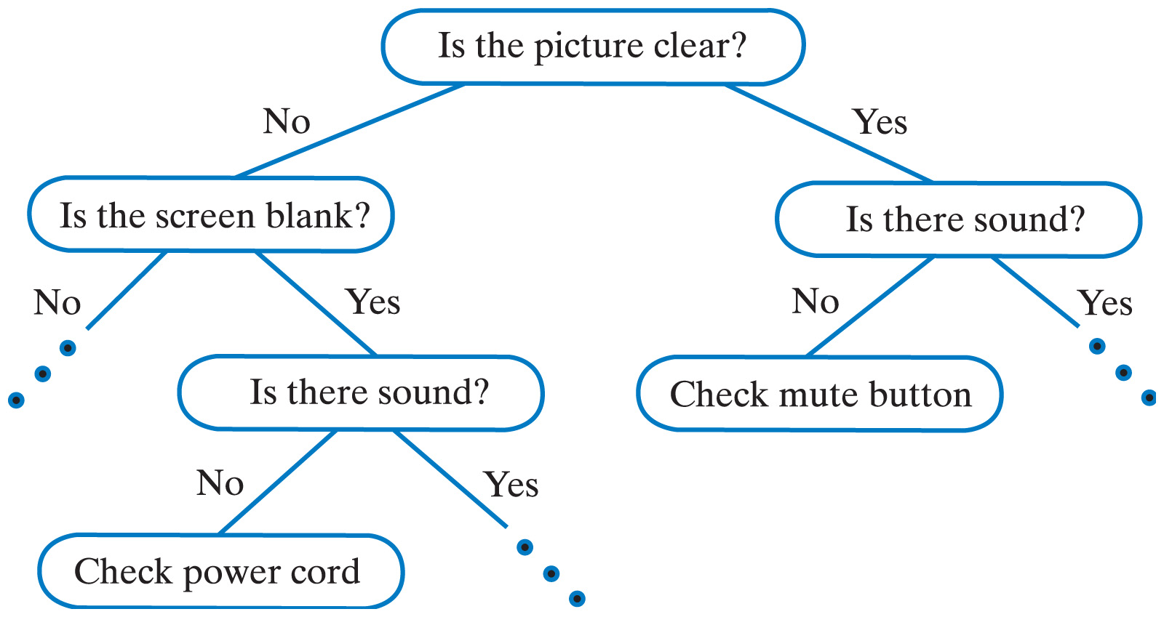
DECISION TREES
Uses conditions to differentiate between data.
Accuracy achieved :
Min : 77
Max : 91
Average = 85

Slide 15
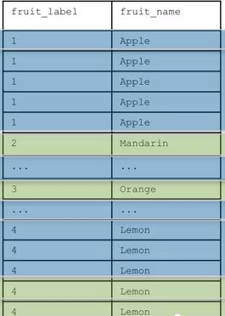
RANDOM FORESTS
Uses groups of trees to classify data.
Make prediction for every single tree.
Then combines all predictions.
More stable, better generalization.
Accuracy achieved :
Min : 84
Max : 95
Average : 89

Slide 16
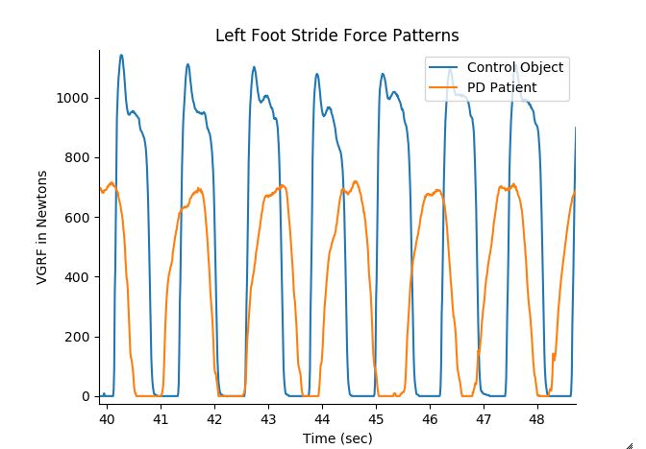
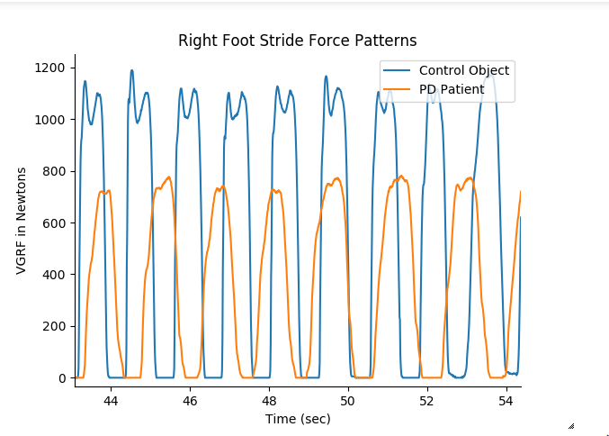
Time Series Analysis
VGRF forces plotted against time depicts the difference in walking patterns

Slide 17
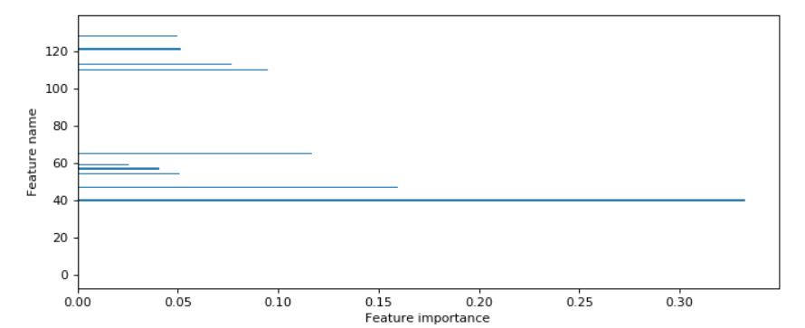
Most Prominent Sensor Analysis
Feature Index values plotted against Feature Importance:
Most Prominent feature as per
Decision trees classifier
VGRF_left_s5Skewness

Slide 18
